Slide 1
SMART CAMS
Be smart and secure

Slide 2
Smart Cams
Smart Cams is a software product that leverages visual recognition services and provides customized solutions to end users.
Here, we use a camera which is empowered with visual recognition abilities that could identify the presence of a person and estimate their age range and gender.
This is extremely helpful for scenarios where customer analytics is valuable from a business perspective.

Slide 3
Why Smart Cams?
Smart Cams allow users to collect, analyze and interpret data in real time.
They collect the demographic data (gender, age, count) of customers that gives meaningful insight into customer behavior patterns. This in turn can be used to improve store performance, pricing and promotion of products, predictive analytics, and workforce/stores streamlining.
This insight helps the users to improve their sales, customer experience and for marketing strategies.
They also provide home security by sending alerts to the users if someone shows up at their door.

Slide 4
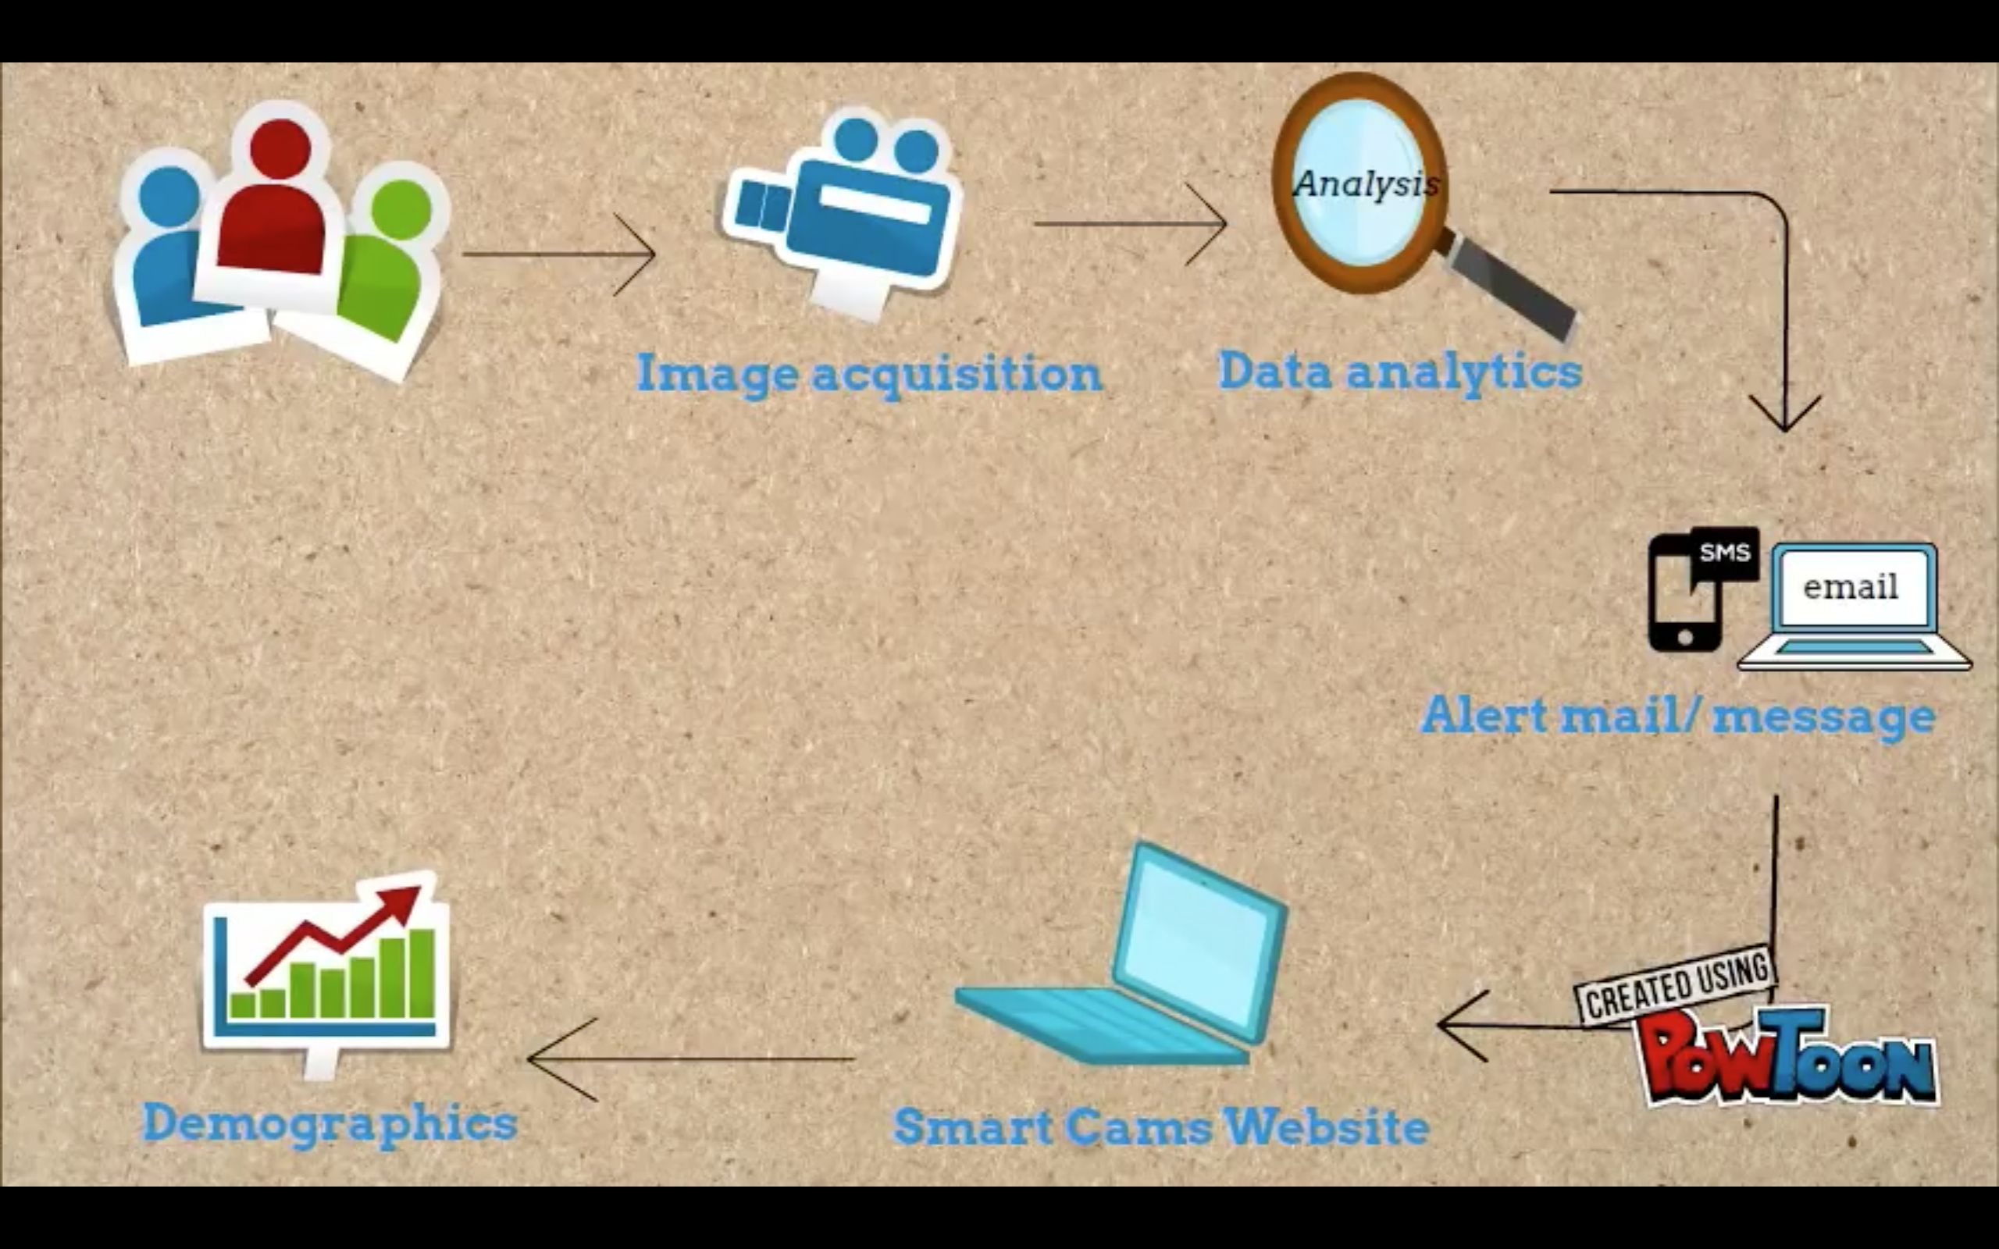
What do we do?

Slide 5
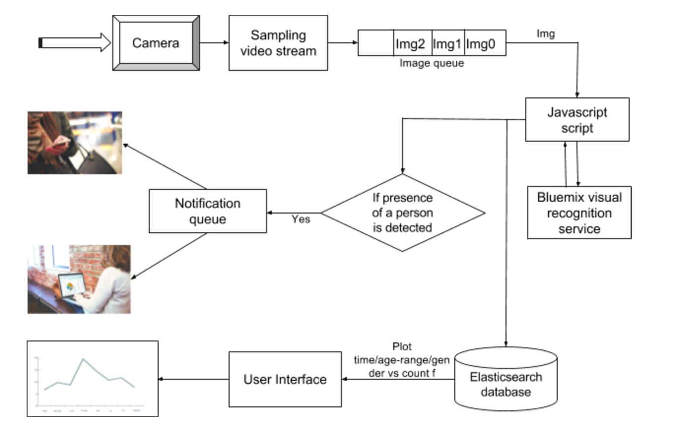
Flow Diagram:

Slide 6
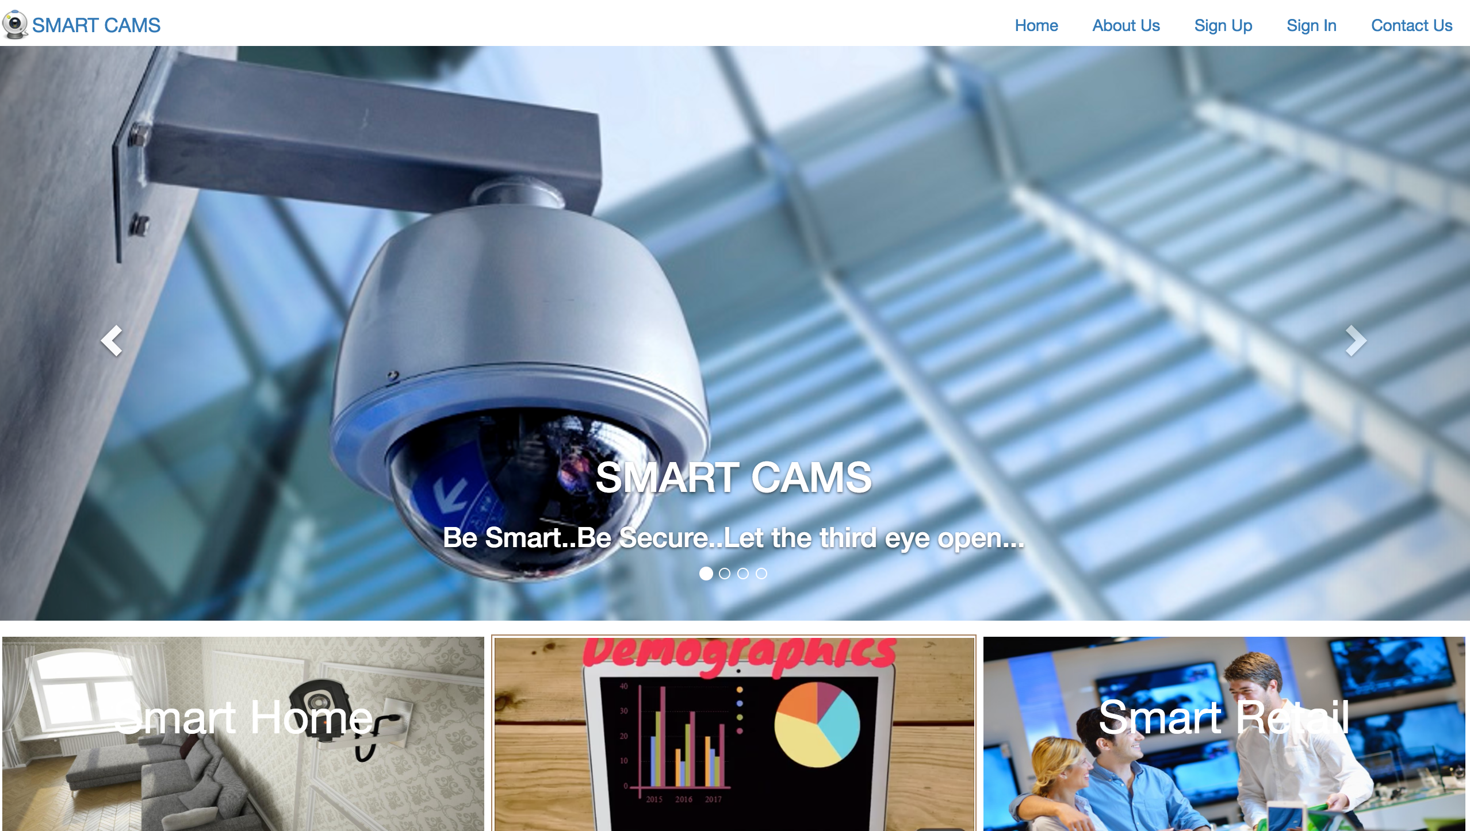
User Interface:

Slide 7
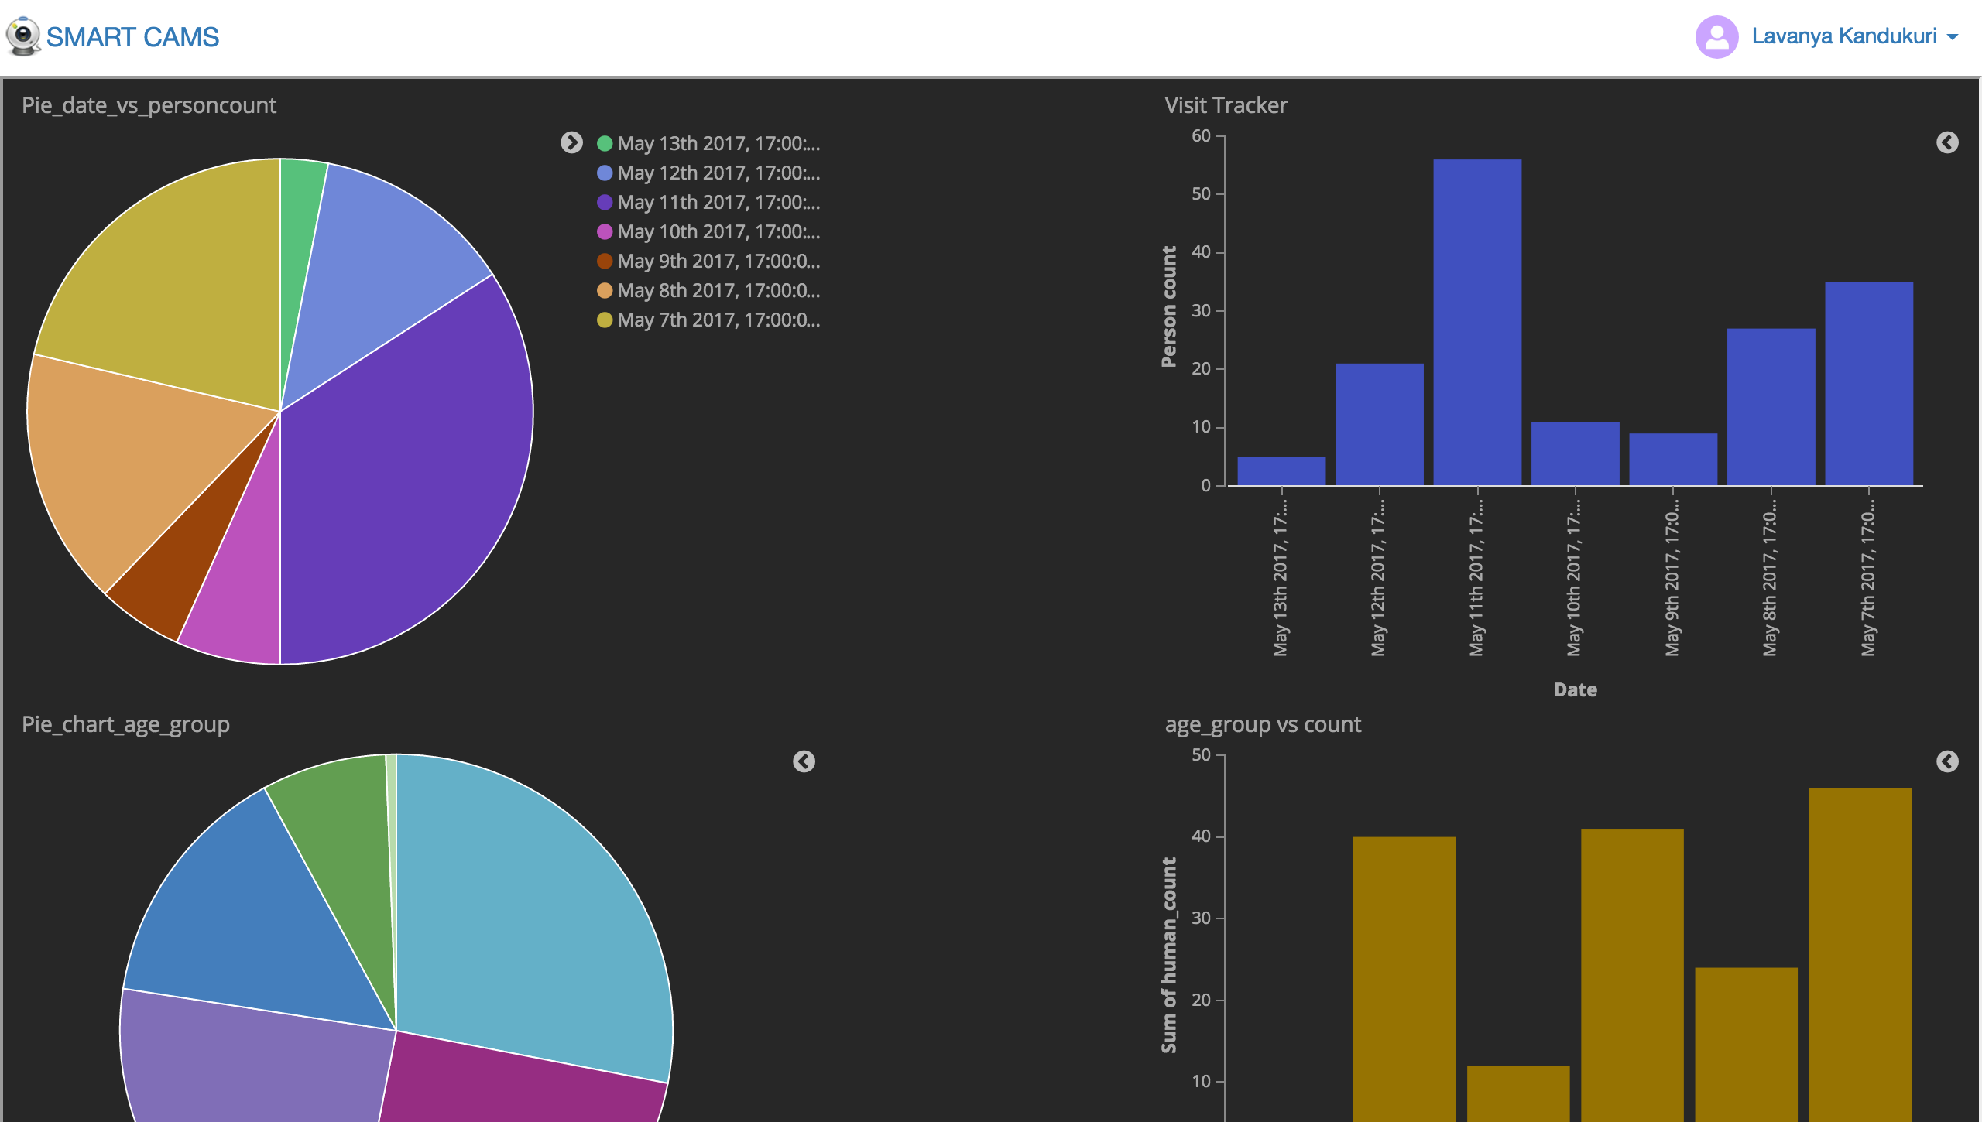
Data Analytics using Kibana:

Slide 8
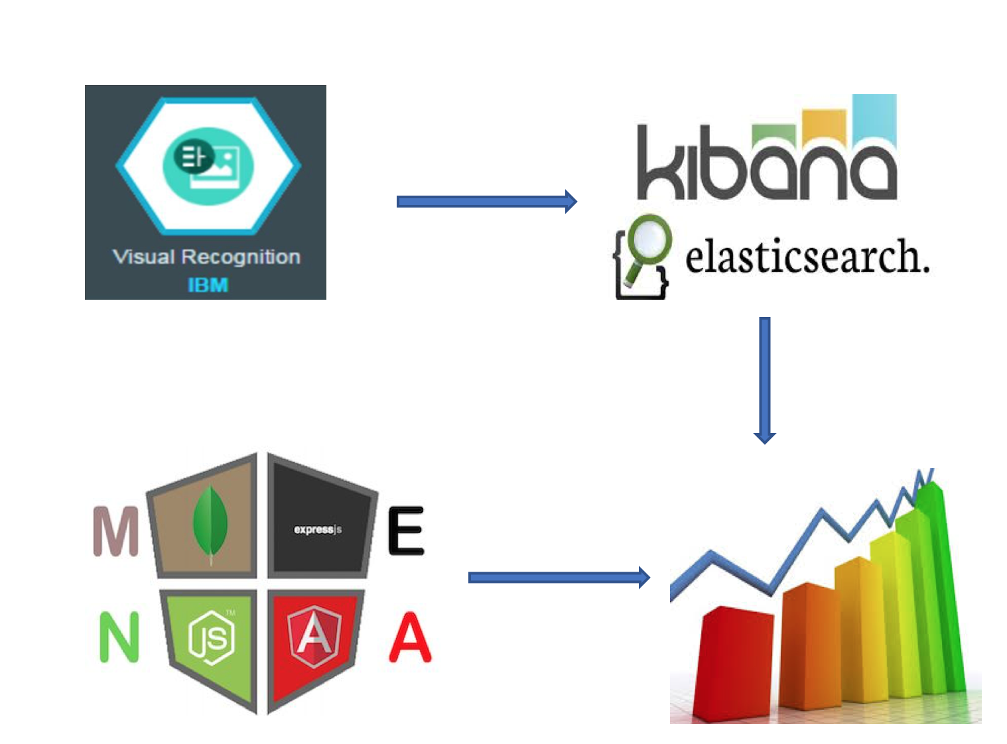
Technology Stack:

Slide 9
Use Cases:
Smart Cams are extremely useful in areas where customer analytics plays an important role. Few examples are:
Restaurants
Shopping stores
Other retail
They can also be used for home security. They are trained to recognize any person loitering around your house and can send alerts containing details of that person(age, gender).

Slide 10
THANK YOU

